Slide 1

Learning Objective
I will use the “work in stages” strategy to multiply and divide
Enter quietly, please be ready with the following on your desk:
Whiteboard
Whiteboard marker
Exercise Book
Pencil, pen, ruler and red pen
Diary
Calculator
Device – charged or borrowed from Library before maths

Slide 2

Daily Review
CFU 1
What is the distributive law?
Distributive law – we split large numbers into 1s, 10s and 100s
CFU 2
What does the distributive law involve?
8 x 18
8 is a small number so we leave it as it is
18 is a large number so we split it into 10 + 8

Slide 3
Daily Review
CFU 1
Distributive law – we split large numbers into 1s, 10s and 100s
How can I split 32?
2 x 43
CFU 2
How can I split 92?
2 is a small number so we leave it as it is
43 is a large number so we split it into 40 + 3
CFU 3
How can I split 59?
2 x (40 + 3)
2x40 + 2x3
80 + 6
86

Slide 4
Daily Review
Distributive law – we split large numbers into 1s, 10s and 100s
Whiteboards
2 x 43
4 x 55
2 x (40 + 3)
2x40 + 2x3
80 + 6
86

Slide 5
Daily Review
Distributive law – we split large numbers into 1s, 10s and 100s
CFU 1
How can I split 87?
15 x 13
13 is the smaller number so we leave it as it is
CFU 2
How can I split 56?
15 is the larger number so we split it into 10 + 5
CFU 3
13 x (10 + 5)
How can I split 37?
13x10 + 13x5
130 + 65
195

Slide 6
Daily Review
We will now add using the ‘make easy numbers’ strategy
Whiteboards
7 + 32 + 13
36 + 55 + 14
= 7 + 13 + 32 (swap the 32 and the 13)
= 20 + 32
= 52

Slide 7
Daily Review
VOCABULARY
Index Form – Simplified into a base and power
(e.g. 7³).
Write the following in expanded form:
Whiteboards
8³
= 8 x 8 x 8
9⁴
VOCABULARY
Expanded Form – Showing all of the multiplications
(e.g. 7 x 7 x 7).
2³
= 2 x 2 x 2
47²
Write the following in index form:
4 x 4 x 4 x 4
= 4⁴
8 x 8 x 8 x 8 x 8
22 x 22
= 22²
2 x 2 x 5 x 5

Slide 8
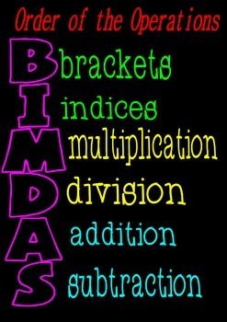
Learning Objective
CFU
What will we learn today?
CFU
I will use the “work in stages” strategy to multiply and divide
How will you know that you are successful?
Success Criteria
At the end of the lesson, I will be able to:
Multiply and divide using the “work in stages” strategy

Slide 9
Activate Prior Knowledge
Split 8 into simpler multiplications
CFU
8 = 4 x 2 = 2 x 2 x 2
On your whiteboard, split 9
Split 12 into simpler multiplications
12 = 6 x 2 = 2 x 3 x 2

Slide 10
Activate Prior Knowledge
Split 10 into simpler multiplications
10 = 5 x 2 (cannot be simplified further)
Split 18 into simpler multiplications
18 = 6 x 3 = 2 x 3 x 3

Slide 11
Whiteboard
Whiteboards
Split the following into simpler multiplications
15
20
9
18
12
32

Slide 12
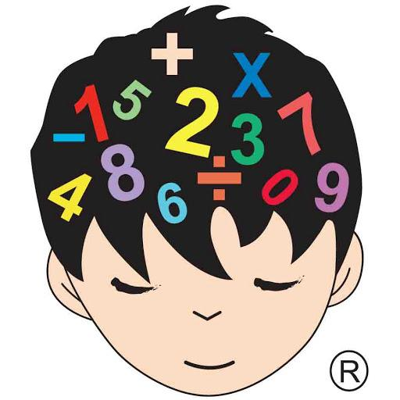
Relevance
CFU 1
When do you need mental strategies?
You will need to develop easy strategies to help you add and multiply without a calculator
CFU 2
What is an example of a real life calculation you could make in a store?
If I have 120 lollies, and I need to divide them evenly between my 8 friends, how many does each of my friends receive?
Luckily, I can use my
mental strategies to help!!

Slide 13
Concept Development
CFU 1
In 5 x 8 = 40, what is the 5?
In the expression: 18 x 27 = 486
CFU 2
In 5 x 8 = 40, what is the 8?
18 is the multiplier
CFU 2
In 5 x 8 = 40, what is the 40?
27 is the multiplier
486 is the product

Slide 14
Concept Development
CFU 1
In 14 ÷ 10 = 1 remainder 4, what is the dividend?
In the expression: 32 ÷ 10 = 3 remainder 2
CFU 2
In 14 ÷ 10 = 1 remainder 4, what is the divisor?
32 is the dividend
CFU 3
10 is the divisor
In 14 ÷ 10 = 1 remainder 4, what is the quotient?
3 is the quotient
CFU 4
In 14 ÷ 10 = 1 remainder 4, what is the remainder?
2 is the remainder

Slide 15
Skill Development
Break down each number by dividing it into parts:
8 = 4 x 2 = 2 x 2 x 2
12 = 4 x 3 = 2 x 2 x 3
28 = 7 x 4 = 7 x 2 x 2
36 = 9 x 4 = 3 x 3 x 2 x 2

Slide 16
Skill Development
Break down each number by dividing it into parts:
Whiteboards
18
30
42
50

Slide 17
Concept Development
CFU 1
What is step 1 in “working in stages”?
Use the “work in stages” strategy to calculate the following:
CFU 2
1) 25 x 4 = 25 x 2 x 2 (Break down the 4)
What is step 2 in “working in stages”?
2) 25 x 2 = 50 x 2 (multiply by the first 2)
= 100 (multiply by the second 2)

Slide 18
Concept Development
CFU 1
What is step 1 in “working in stages”?
Use the “work in stages” strategy to calculate the following:
CFU 2
1) 27 x 4 = 27 x 2 x 2 (Break down the 4)
What is step 2 in “working in stages”?
2) 27 x 2 = 54 x 2 (multiply by the first 2)
= 108 (multiply by the second 2)

Slide 19
Concept Development
Use the “work in stages” strategy to calculate the following:
Whiteboards
1) 45 x 8 (Break down the 8)
= 45 x 4 x 2
= 45 x 2 x 2 x 2

Slide 20
Guided Practice
Calculate the following using the “work in stages”
Strategy:
Whiteboards
34 x 8 (break the 8 down by dividing it into parts)

Slide 21
Guided Practice
Calculate the following using the “work in stages”
Strategy:
Whiteboards
35 x 9

Slide 22
Guided Practice
CFU 1
What is the first step in “work in stages”?
Calculate the following using the “work in stages”
Strategy:
CFU 2
900 ÷ 15 (break the 15 down by dividing it into parts)
What is the second step in “work in stages”?
900 ÷ 3 ÷ 5 (divide 900 by 3)
300 ÷ 5 (divide 300 by 5)
60

Slide 23
Guided Practice
CFU 1
What is the first step in “work in stages”?
Calculate the following using the “work in stages”
Strategy:
CFU 2
200 ÷ 8 (break the 8 down by dividing it into parts)
What is the second step in “work in stages”?
200 ÷ 4 ÷ 2 (break the 4 down by dividing it into parts)
200 ÷ 2 ÷ 2 ÷ 2 (divide 200 by the first 2)
Whiteboards

Slide 24
Guided Practice
CFU 1
What is the first step in “work in stages”?
Calculate the following using the “work in stages”
Strategy:
Whiteboards
CFU 2
200 ÷ 25
What is the second step in “work in stages”?

Slide 25

Skill Closure
What have we learnt today?
Lesson Objectives:
I will use the “work in stages” strategy to multiply and divide
Break down each number into parts
20 = 5 x 5
50 = 10 x 5 = 2 x 5 x 5
75 = 15 x 5 = 3 x 5 x 5

Slide 26


Independent Practice
Mathematics Page Layout
Open your textbooks to:
Chapter 1.3
Questions: 1, 7, 8

